Slide 1
Comparing the Effectiveness of Stemming and Lemmatization in Arabic Text Summarization with XLSum
Ahmed Eid, Marwan Farag, Mohamed Abdelhamid
Supervised by:
Dr. Mervat Abulkheir
Eng. Mayar Osama

Slide 2
Contents
Overview / Related Work
Motivation
Dataset
Challenges / How we deal with them?

Slide 3
Overview
Two angles of summarization (based on input): single-document and multi-document
Two angles of summarization (based on output): abstractive and extractive
Doc1
Doc1
Summary1
Summary
Doc2
Doc2
Summary2

Slide 4
Related Work
Extractive Summarization
-Statistical based method * (e.g. mostly by term frequency).
It is the most commonly used method for scoring sentences: The sentence’s score is determined by the number of frequencies and avoiding all stop words.
Disadvantages:
1-Lack of Contextual Understanding
2-Difficulty in Handling Ambiguity
3-Vulnerability to Noise
4-Lack of Coherence
* F. Alotaiby, ‘‘New approaches to automatic headline generation for Arabic documents,’’ J. Eng. Comput. Innov., vol. 3, no. 1, pp. 11–25, Feb. 2012
Notes:
Lack of Contextual Understanding: Statistical-based methods do not have a deep understanding of the meaning of the text. They rely solely on the frequency of words and the relationships between them to generate a summary. This can result in summaries that do not capture the overall context and meaning of the original text.
Difficulty in Handling Ambiguity: Statistical-based methods may struggle to deal with ambiguous words and phrases, which can result in inaccurate or misleading summaries. For example, a word like "bank" can have multiple meanings (e.g. financial institution, riverbank, etc.), and statistical-based methods may not be able to determine the correct meaning in a given context.
Limited Coverage: Statistical-based methods may not be able to summarize texts that contain rare or uncommon words or phrases, which can result in incomplete summaries.
Vulnerability to Noise: Statistical-based methods may be sensitive to noise in the text, such as spelling errors or typos, which can result in inaccurate or misleading summaries.
Lack of Coherence: Since statistical-based methods rely solely on frequency and relationships between words, they may produce summaries that lack coherence and do not flow smoothly, making them difficult to read and understand.

Slide 5
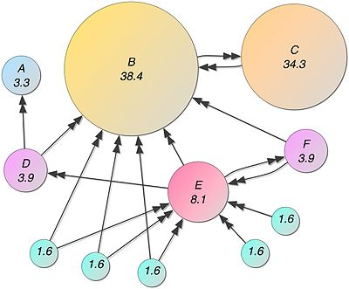
Related Work
Extractive Summarization
-Graph based method * (e.g. PageRanking algorithm).
Cluster similar sentences in one group.
Select sentences with a high score from each cluster to reduce redundancy
Avoid selecting sentences from the same cluster at the same time. To eliminate repetition and
boost relevance, they extract and give scores to the most important and distinctive
phrases in the document.
Disadvantages of Graph based methods
-Lack of semantic understanding.
-Overemphasis on connectivity.
-Lack of coherence
-Limited ability to handle new information
* Al-Taani, A. T., & Al-Omour, M. M. (2014). An extractive graph-based Arabic text summarization approach. In The International Arab Conference on Information Technology (pp. 158-163).

Slide 6
Related Work
Abstractive Summarization
Tree based summarization *
Identifies similar sentences and represents them as a tree structure.
The tree is then pruned, which means removing unnecessary parts, and converted to a concise summary.
Disadvantages
-It requires identifying common terms between sentences
-It may miss important phrases that are not in the context.
-It is also more focused on syntax than semantics, which limits its effectiveness.
Other methodologies include semantic based summarization and ontology based summarization
* Knight, K., & Marcu, D. (2000). Statistics-based summarization step one: Sentence compression. In AAAI-00.

Slide 7
Related Work
Abstractive Summarization
Deep Learning Seq2Seq models
RNNs, LSTMs, Transformers, BART, and….
AraBART *: AraBART achieves the best performance on multiple abstractive summarization datasets, outperforming strong baselines including a pretrained Arabic BERT-based models and multilingual mBART and mT5 models.
* Moussa Kamal Eddine, Nadi Tomeh, Nizar Habash, Joseph Le Roux, and Michalis Vazirgiannis. Arabart: a pretrained arabic sequence-to-sequence model for abstractive summarization. arXiv preprint arXiv:2203.10945, 2022

Slide 8
Motivation
Text summarization can be used to aggregate news articles from various sources and provide users with a summary of the most important events and developments.
Text summarization can be useful in legal documents.
Summarization can be used to extract key insights and trends from business reports.
Text summarization can be used in educational resources

Slide 9
Motivation: Stemming or lemmatization
In the case of Arabic text summarization, it is important to experiment with both stemming and lemmatization to determine which approach yields better results.
To the best of our knowledge, there has been no researches concerned with evaluating the effect of stemming/lemmatization or neither on Arabic text summarization task.
Notes:
Sobeih will give us why someone might be confused when choosing whether to stem or lemmatize when preprocessing for a text summarization task

Slide 10
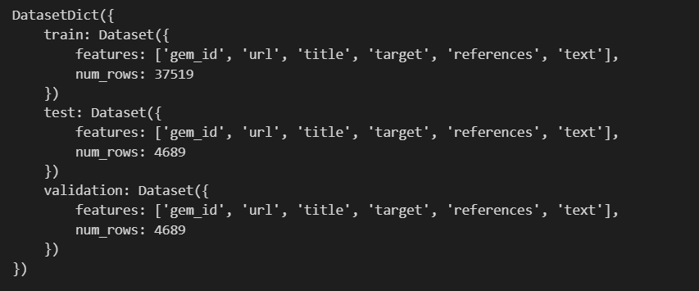
Dataset: Xlsum arabic
The XLSum Arabic dataset consists of approximately 45,000 news articles collected from various Arabic news sources, such as Al Jazeera, Al Arabiya, and BBC Arabic.
The articles cover a wide range of topics, including politics, economics, sports, and culture.
Each article in the dataset is accompanied by a corresponding summary, which was manually created by a human summarizer.

Slide 11
Dataset: Xlsum arabic
Why this dataset?
-Free
-Size is sufficient for our task (according to our modest experience).
-It will help us overcome one of the challenges in Arabic text summarization, the lack of gold standard corpus.

Slide 12
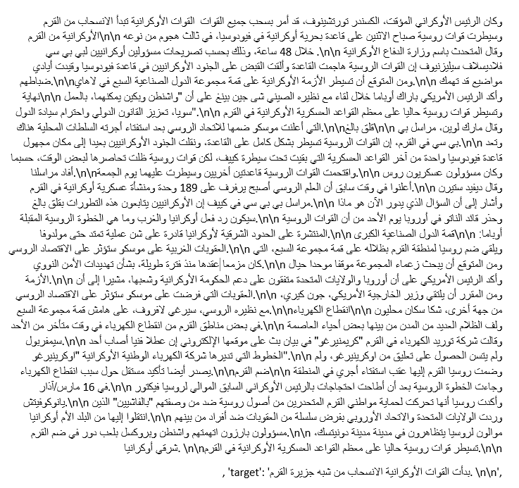
Example entry

Slide 13
Challenges
Homography
Large size of vocabulary and text noise
Lack of gold standard corpus
Stemming and Lemmatization
Diacritics, Punctuations

Slide 14
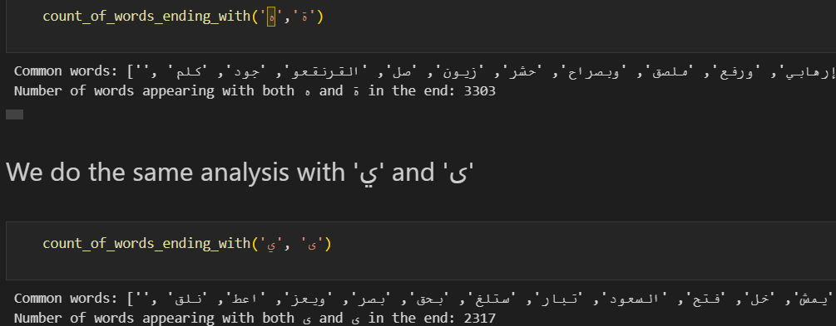
Homography
Words that are written differently but have the same meaning.
Arabic has several homographic words, such as the use of ه and ة at the end of words, or ي and ى. Eg: 'المستقبلية' and 'المستقبليه'

Slide 15
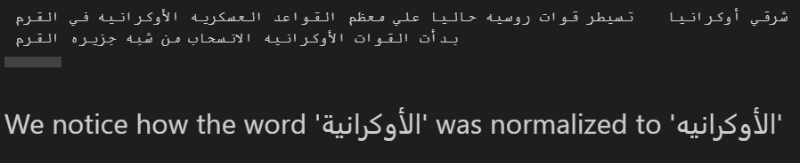
Homography
Thus, we need to normalize by replacing ‘ة’ with ‘ه’ and ‘ى’ with ‘ي’

Slide 16
Large size of vocabulary and text noise
One challenge is that stop words can add noise to the text and reduce the effectiveness of certain natural language processing algorithms.
Plan to solve: By removing stop words, we can improve the accuracy of the topic modeling algorithm, extract more meaningful topics and reduce the size of the vocabulary to make it easier to analyze and process the text.

Slide 17
Lack of gold standard corpus
According to *, The main issue with text summarization datasets is the lack of high-quality reference summaries, which makes it challenging to obtain an excellent dataset.
Furthermore, there is a scarcity of multi-sentence datasets for abstractive summarization in many languages, including Arabic, with only single sentence datasets being available
* Elsaid, A., Mohammed, A., Ibrahim, L. F., & Sakre, M. M. (2022). A comprehensive review of arabic text summarization. IEEE Access, 10, 38012-38030.

Slide 18
Do we need stemming or lemmatization or neither?
While stemming reduces words to their root form by removing affixes, lemmatization maps words to their base or dictionary form while retaining the meaning of the word.
At the same time stemming is appropriate identifying common roots. Arabic has a rich system of word roots, with many words sharing the same root. For example, the root كتبis the basis for words like كاتبmeaning "writer", كتابة meaning "writing", كتاب meaning "book", and many others.
Hence, Stemming algorithms can group together words that share a common root, making it easier to identify key themes in a text and create a summary that captures the essence of the original content.
In * they claim that doing lemmatization preprocessing step will give the best accuracy.
Reda Elbarougy, Gamal Behery, and Akram El Khatib. A proposed natural language processing preprocessing procedures for enhancing arabic text summarization. Recent Advances in NLP: The Case of Arabic Language, pages 39–57, 2020.

Slide 19
Do we need stemming or lemmatization or neither?
Three setups / experiments:
1-Dataset preprocessed with stemming
2-Dataset preprocessed with lemmatization
3-Dataset preprocessed with neither stemming nor lemmatization

Slide 20
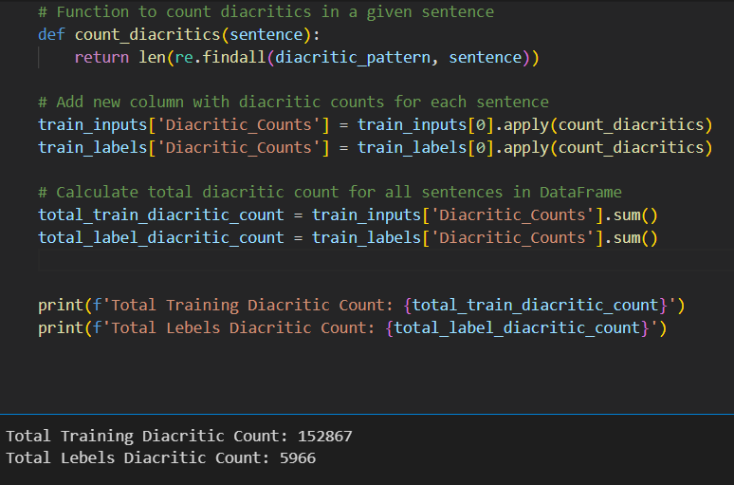
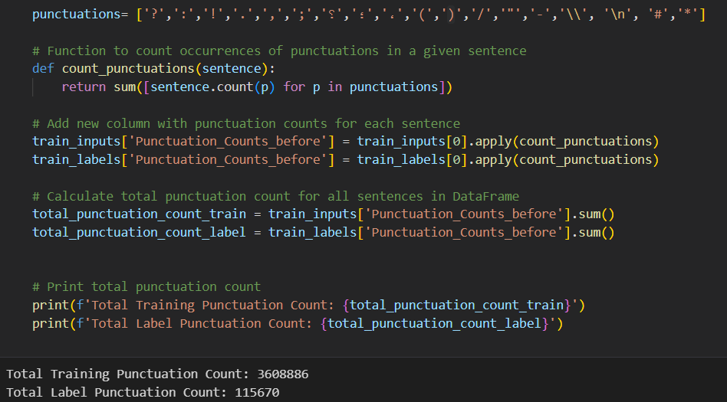
Diacritics, Punctuations
Removing them can help normalize the text and make it easier to compare different texts.

